Slide 1

WSO2 API Manager 4.0.0 Developer Fundamentals
Product Administration
WSO2 Training

Slide 2
Introduction to User Management
Defining and managing
Users
Roles
Permission
Link - User Management

Slide 3
Managing User Roles
Roles contain permissions for users to manage the server.
Can be reused.
Eliminate the overhead of granting permissions to users individually.
Following Roles exist by default,
Admin
Internal/everyone
Internal/system
Internal/analytics
Internal/creator
Internal/subscriber
Internal/publisher
Internal/devops
Link: User Roles
Notes:
admin - Provides full access to all features and controls. By default, the admin user is assigned to both the admin and the Internal/everyone roles.
Internal/everyone - This is a predefined role that is used to group all the users (across the user stores) together. When you create a new user, automatically the user belongs to the Internal/everyone role. It does not include any permissions. This role can be used to identify all logged in users.
Internal/system - This is another pre defined role which does not include any permissions. Unlike the Internal/everyone role, this role is not assigned to a user by default.
Internal/analytics - This role can be assigned to users who do not have the publisher or subscriber roles assigned but need permission to view the analytics dashboards.
Internal/creator: A creator is typically a person in a technical role who understands the technical aspects of the API (interfaces, documentation, versions etc.) and uses the API publisher to provision APIs into the Developer Portal. The creator uses the Developer Portal to consult ratings and feedback provided by API users. Creator can add APIs to the Developer Portal but cannot manage their lifecycle. Governance permission gives a creator permission to govern, manage and configure the API artifacts.
Internal/publisher: A person in a managerial role and overlooks a set of APIs across the enterprise and controls the API lifecycle, subscriptions and monetization aspects. The publisher is also interested in usage patterns for APIs and has access to all API statistics.
Internal/subscriber: A user or an application developer who searches the Developer Portal to discover APIs and use them. S/he reads the documentation and forums, ratings/comments on the APIs, subscribes to APIs, obtains access tokens and invokes the APIs.
Internal/devops: Has the ability to perform all the apictl related operations. You can create a new user and assign this role to do the apictl operations.

Slide 4
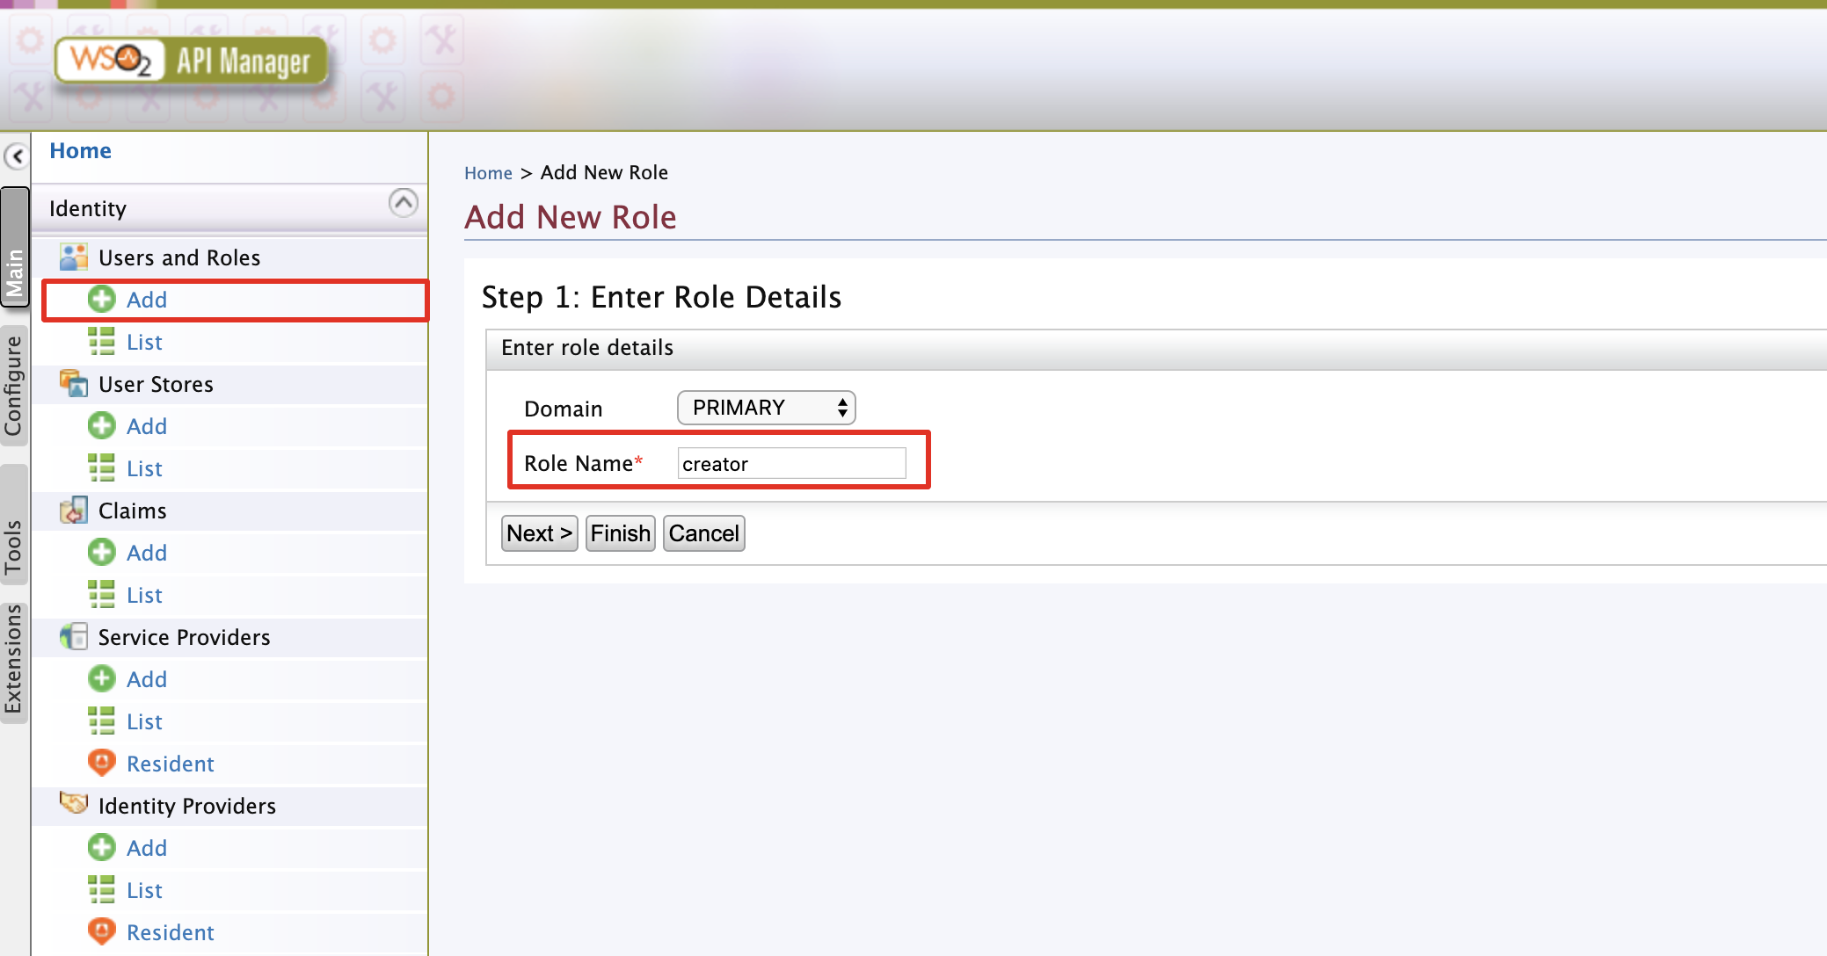
Create a New User Role
Notes:
Log into the API Manager carbon console (https://localhost:9443/carbon) as admin user. (username: admin, password: admin)
Go to,
Users and Roles -> Add -> Add new Role
Provide the name of the role and click Finish.

Slide 5
Managing Role Permissions
Permissions can be granted to a role at two levels:
Super Tenant level: A role with super tenant permissions is used for managing all the tenants in the system and also for managing the key features in the system, which are applicable to all the tenants.
Tenant level: A role with tenant level permissions is only applicable to individual tenant spaces.
Link : Role Permissions

Slide 6
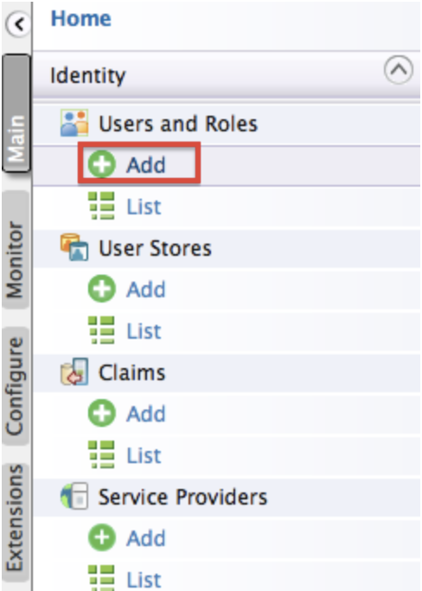
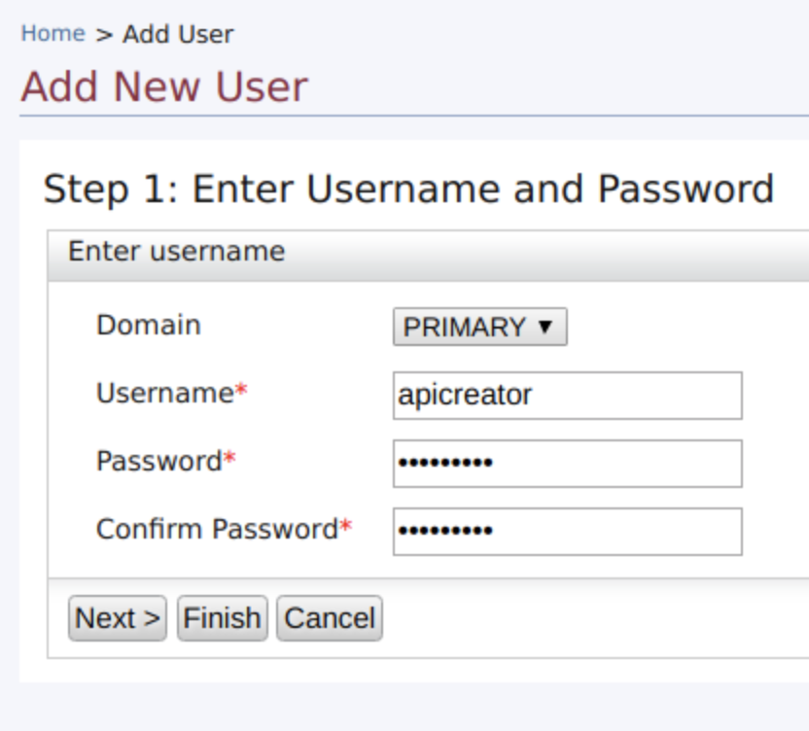
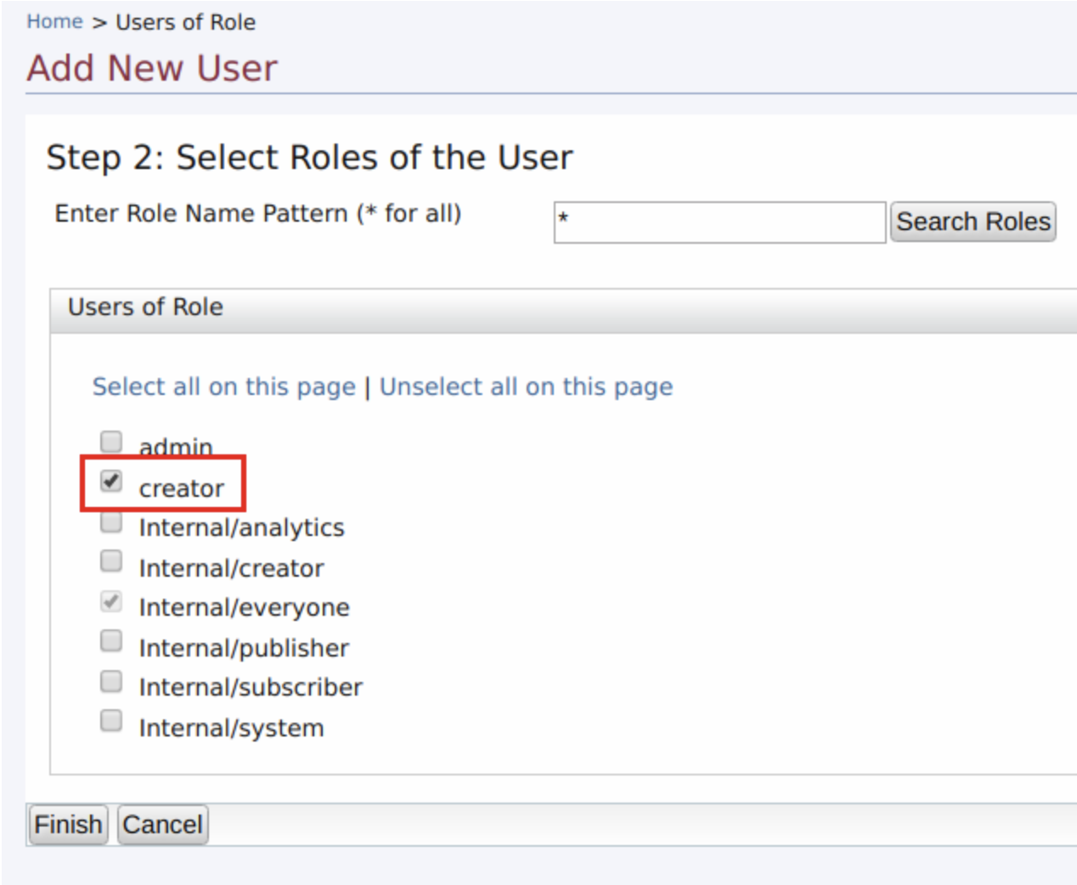
Managing Users
Adding User
Log in to the Management Console ( https://<hostname>:9443/carbon ) and click Add under Users and Roles in the Main menu.

Slide 7
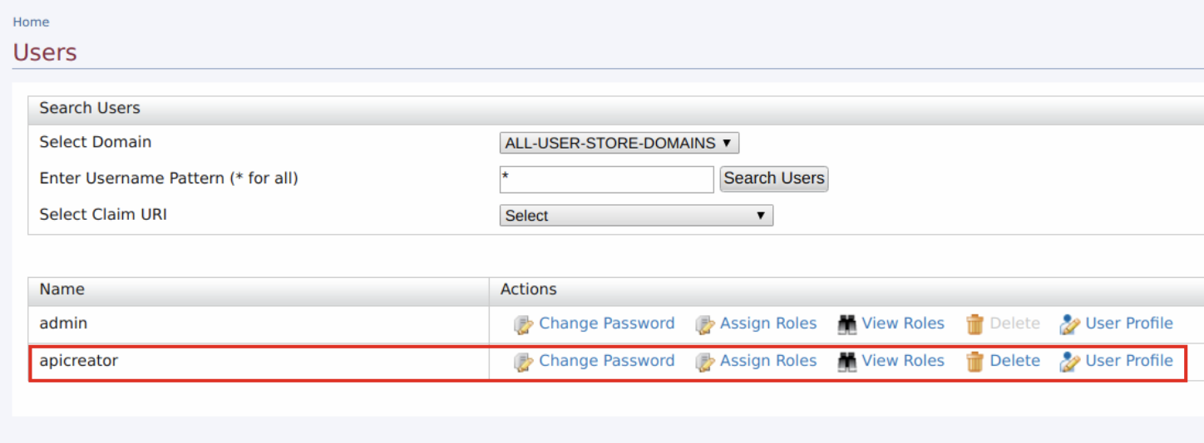
Managing Users

Slide 8
Managing Scope-Role Mappings
API Manager 4.0.0 Publisher and Developer portals are based on API Manager REST APIs which are secured with OAuth2. Each resource is bound with specific scopes.
Each scope is associated with API Manager internal roles. (Internal/publisher, Internal/subscriber etc)
To grant the access to the newly created user with creator role, it should be mapped to a proper internal role. E.g., creator -> Internal/creator
Notes:
Scope: Scopes are Role based access control mechanism which can be enforced to API Resources.
If a scope is associated with a resource, the access token used to invoke the resource must have the required scope.

Slide 9
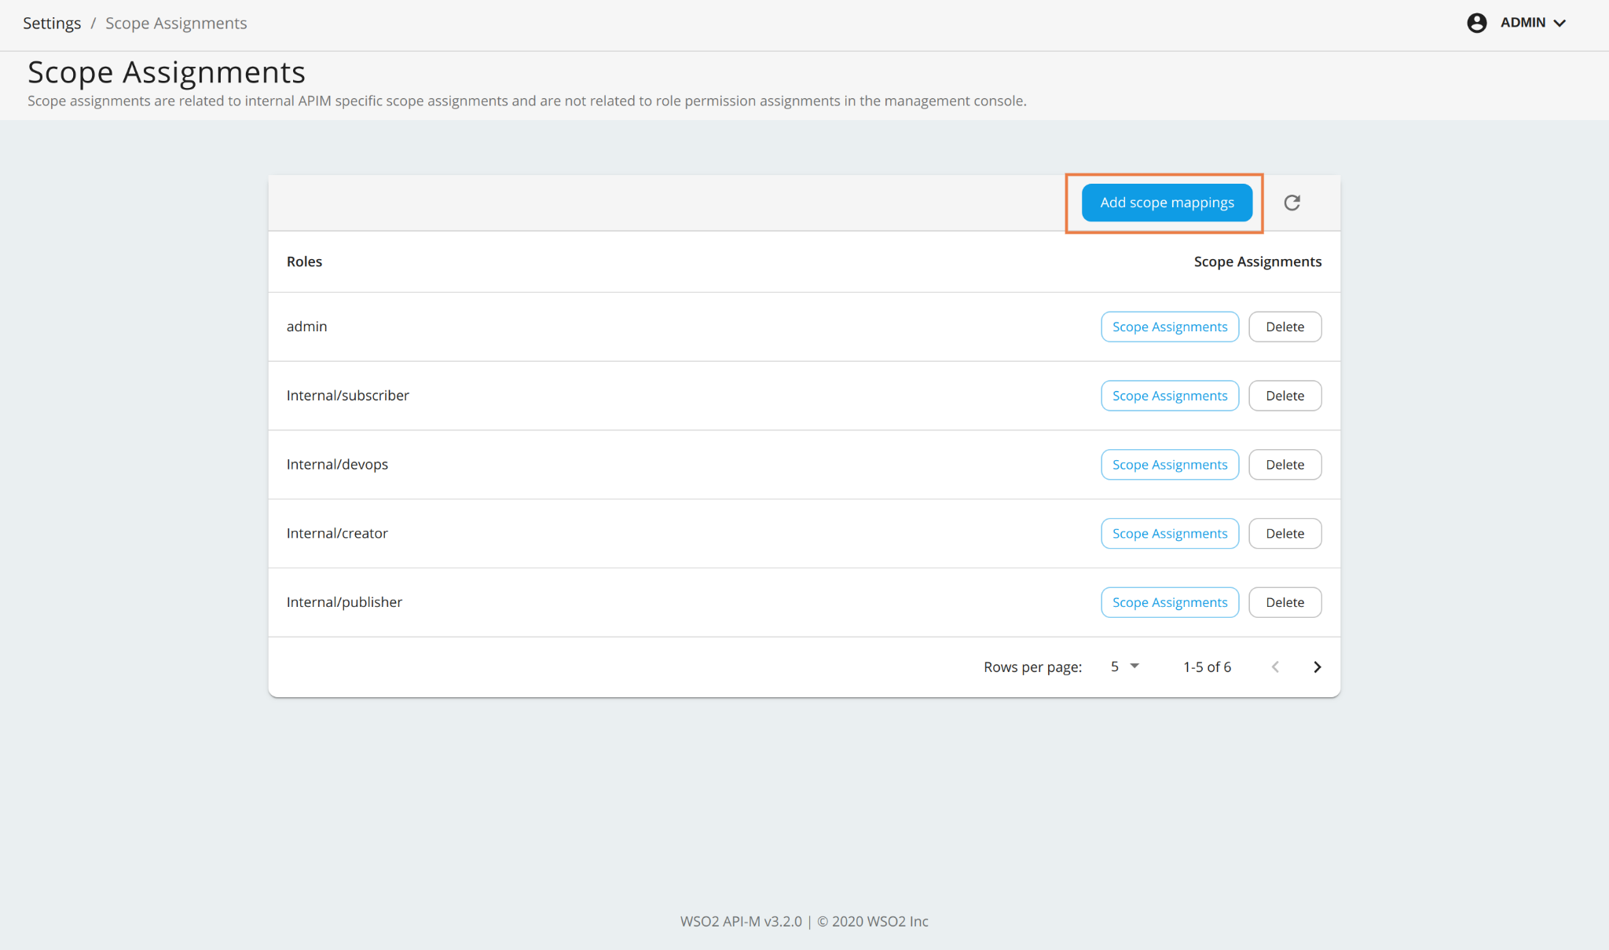
Managing Scope-Role Mappings
Log in to the API Manager Admin Portal (https://<hostname>:9443/admin) and go to Settings -> Scope Assignments.

Slide 10
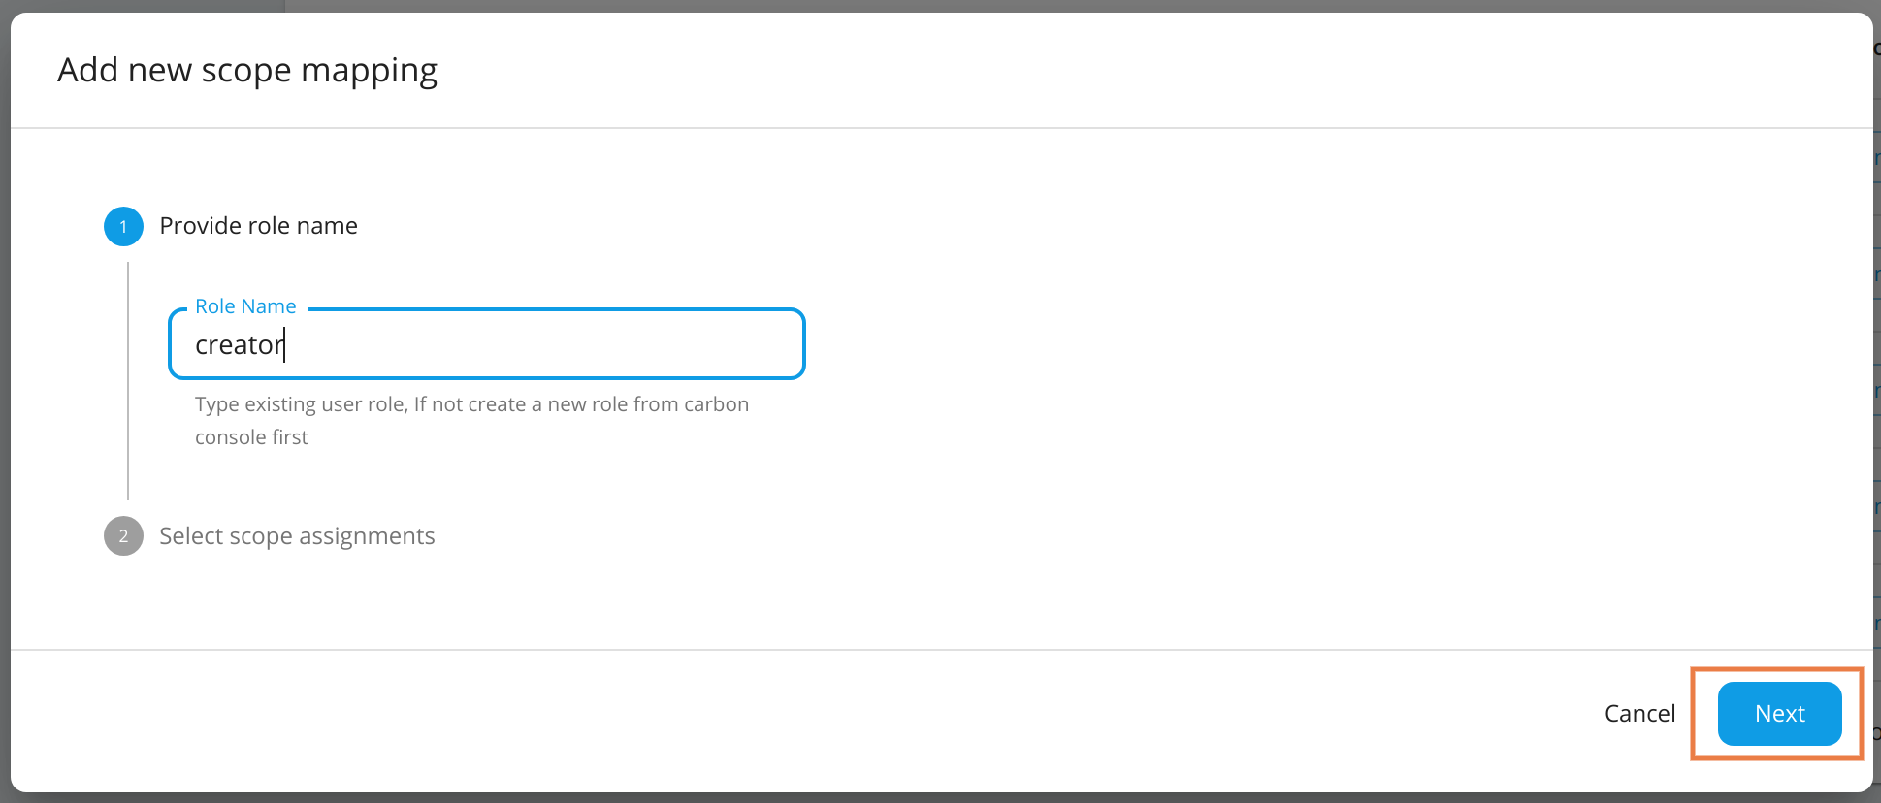
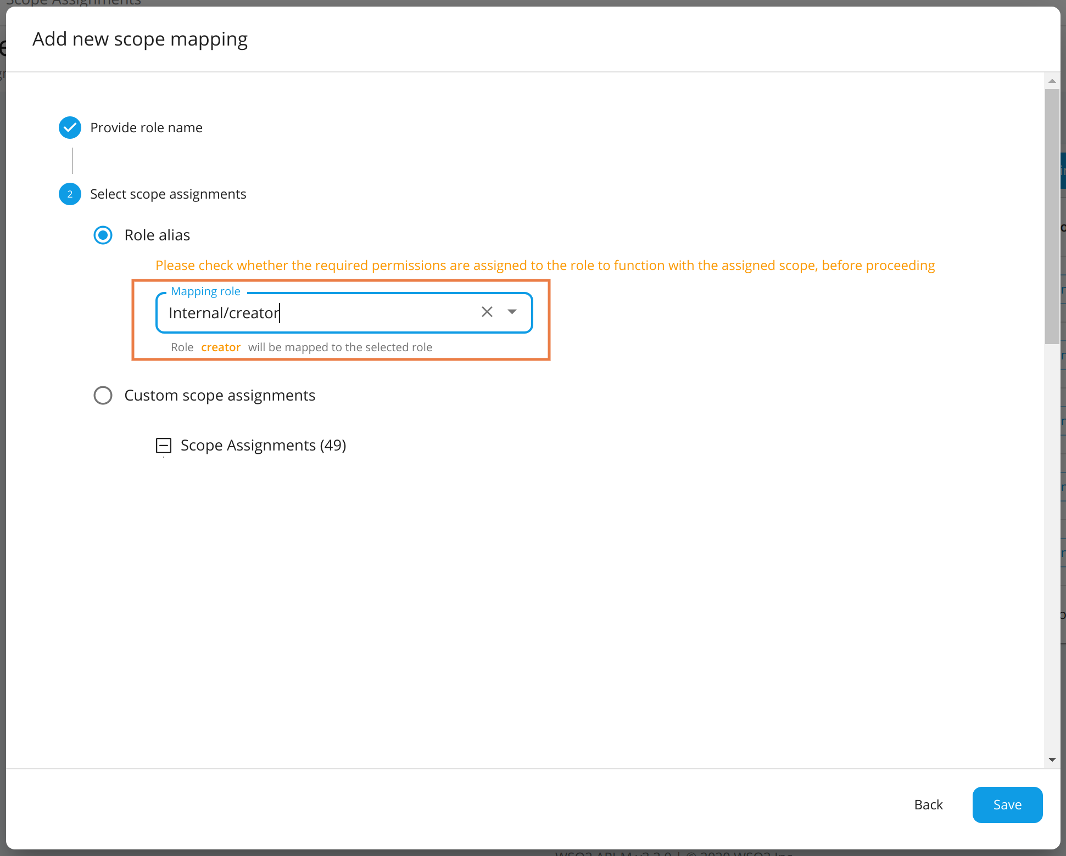
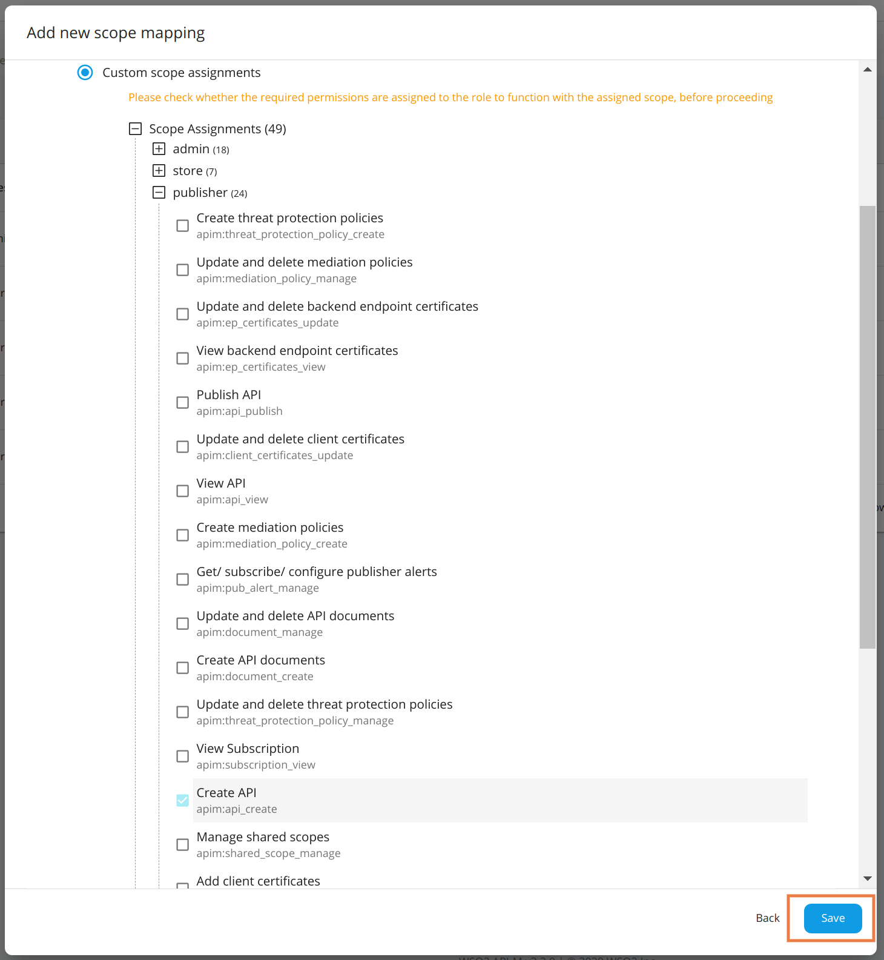
Managing Scope-Role Mappings
Click on Add scope mappings.
Notes:
Refer https://apim.docs.wso2.com/en/4.0.0/administer/managing-users-and-roles/managing-permissions/#adding-api-m-specific-scope-assignments

Slide 11
Managing Scope-Role Mappings - Role Alias
New roles can be mapped to existing Internal/* roles, created roles, and admin. All the scopes associated with the selected existing role will be mapped to the new role automatically.
If you want to map the scopes of Internal/creator to the new creator role, select Internal/creator from the drop-down menu and save.
This will update all scope mappings in the tenant-conf.json file with Internal/creator as an allowed role resulting in the new creator role to be allowed for all scopes allowed for the Internal/creator role.

Slide 12
Introduction to User Stores
A user store is the database where information of the users and/or user roles are stored.
User Information:
Usernames, Passwords, First Name, Last Name, Email, etc.
By default it uses an embedded h2 database.
Permissions and other authorization related information is stored in a separate database called the user management database, which by default is H2 as well.
You can also
Configure a primary user store instead of using embedded h2 database.
Configure several secondary user stores as well.
Configure your own customized user stores and connect them with the products as secondary stores.
Docs Link: User Stores

Slide 13
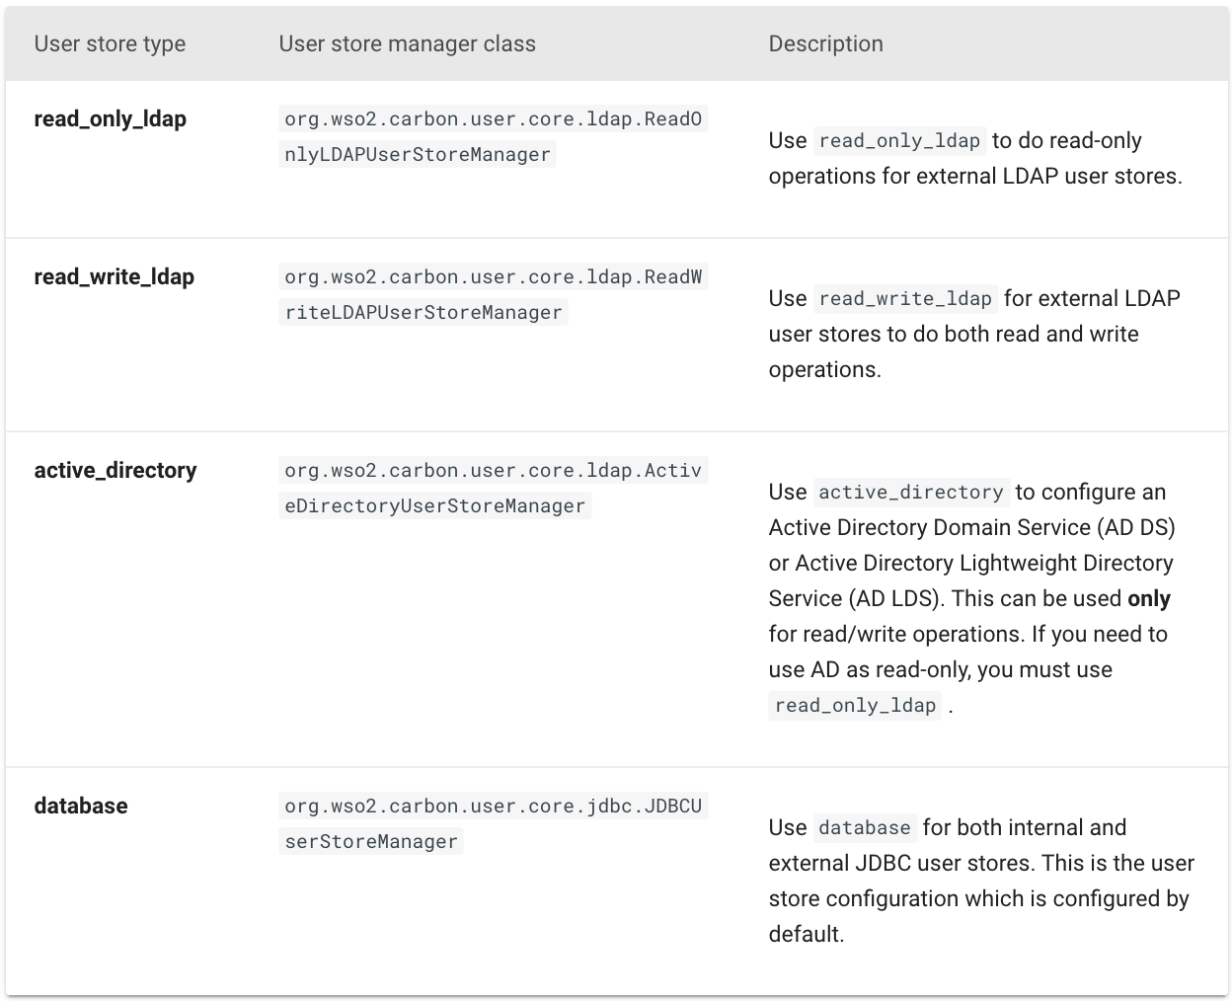
User Store Types
There are four user store types.
User Store Manager types.

Slide 14
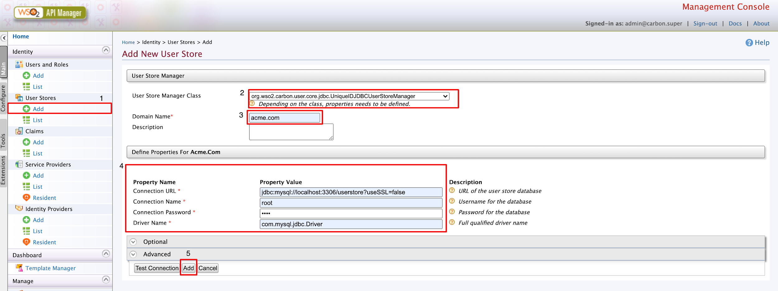
Configuring a Secondary User Store
Log in to the carbon console and, go to User Stores > Add
Select the user store type
Enter the user store domain.
Enter the user store connection properties
Click Add button to add the user store.

Slide 15
Configuring a Secondary User Store Manually
When you configure multiple user stores, you must give a unique domain name to each user store in the <DomainName> element.
If it is the configuration of a super tenant, save the secondary user store definitions in <APIM_HOME>/repository/deployment/server/userstores directory.
If it is a general tenant, save the configuration in <APIM_HOME>/repository/tenants/<tenantid>/userstores directory
The secondary user store configuration file must have the same name as the domain with an underscore (_) in place of the period. For example, if the domain is wso2.com, name the file as wso2_com.xml
Only one file should contain the definition for one user store domain.
Configuring a Secondary User Store Manually

Slide 16
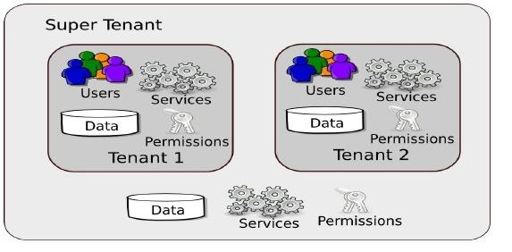
Introduction to Multi Tenancy
Maximize resource sharing by allowing multiple users (tenants) to log in and use a single server/cluster at the same time, in a tenant-isolated manner.
Ensures optimal performance of the system's resources such as memory and hardware
Secures each tenant's personal data.
Register tenant domains using the Management Console.
Features of multi tenanted environment
Tenant isolation
Data isolation
Execution isolation
Performance Isolation
Link : Introduction to Multi tenancy
Notes:
What is Multi Tenancy?
Logically isolated entities, sharing the same infrastructure.
All tenants share the same database, user store and other services. But, one tenant’s information cannot be accessed by another tenant.
Tenant isolation Each tenant has its own domain, which the other tenants cannot access.
Data isolation Each tenant can manage its data securely in an isolated manner.
Execution isolation Each tenant can carry out business processes and workflows independent of the other tenants. No action of a tenant is triggered or inhibited by another tenant.
Performance Isolation No tenant has an impact on the performance of another tenant.

Slide 17
Multi Tenancy
An Individual Tenant can perform the following:
Deploying artifacts
Applying Security
User Management
Data Management
Request Rate Limiting
Response Caching
Methods for sharing resources among tenants
Private Jet mode
Separation at hardware level
Separation at JVM level
Native multi tenancy
Notes:
Private Jet mode : This method allows the load of a tenant ID to be deployed in a single tenant mode. A single tenant is allocated an entire service cluster. The purpose of this approach is to allow special privileges (such as priority processing and improved performance) to a tenant.
Separation at hardware level : This method allows different tenants to share a common set of resources, but each tenant has to run its own operating system. This approach helps to achieve a high level of isolation, but it also incurs a high overhead cost.
Separation at JVM level : This method allows tenants to share the same operating system. This is done by enabling each tenant to run a separate JVM instance in the operating system.
Native multi tenancy : This method involves allowing all the tenants to share a single JVM instance. This method minimises the overhead cost.

Slide 18
Updating WSO2 API Manager Using WSO2 Updates 2.0
WSO2 Updates 2.0 : WSO2 Updates include improvements that are released by WSO2, on top of a released WSO2 product version. With updates, you do not have to wait until the next product version release to get the product enhancements and security fixes.
Refer https://updates.docs.wso2.com/en/latest/updates/overview/ for more details on how to update WSO2 APIM 4.0.0 using Updates 2.0.

Slide 19
Let’s try it out!
Working with Tenants

